Slide 1
Section 1.3 Do the Numbers Make Sense?

Slide 2
Snapple's "Real Facts"
The average American walks 18,000 steps a day.
(2)August has the highest percent of births.
(3)The average person spends about 2 years on the phone in a lifetime.
(4)Termites eat through wood 2 times faster when listening to rock music.

Slide 3
What didn't they tell us?
The most common way to mislead with data is to cite correct numbers that don’t mean what they appear to say because we aren't told the full story.

Slide 4
What didn't they tell us?
A.R.M. Allergy Relief Medicine switched to "new formula maximum strength." But the old formula had 37.5 mg of active ingredient and Maximum strength had only 25 mg. Consumer Reports queried the manufacturer. It seems that the Food and Drug Administration proposed to limit dosage to 25 mg. So the company lowered the strength of a tablet and called it "maximum strength" because the lower dose is the federal maximum.

Slide 5
Example 1.21: Yet More Snow
News reports of snowstorms say things like “A winter storm spread snow across the area, causing 28 minor traffic accidents.” Eric Meyer, a reporter in Milwaukee, Wisconsin, says he often called the sheriff to gather such numbers. One day he decided to ask how many minor accidents are typical in good weather: about 48, said the sheriff.
Perhaps, says Meyer, the news should say “Today’s winter storm prevented 20 minor traffic accidents.
The point: numbers have a context. If you don’t know the context, the number doesn’t tell you much.

Slide 6
Example 1.22-We attract really good students
Colleges know that many prospective students look at popular guidebooks to decide where to apply for admission. The guidebooks print information supplied by the colleges themselves. Surely, no college would simply lie about, say, the average SAT score of its entering students. But we do want our schools to look good.
How about leaving out the scores of our international and remedial students?

Slide 7
Northeastern University did this, making the average SAT score of its freshman class 50 points higher than if all students were included.
If we admit economically disadvantaged students under a special program sponsored by the state, surely no one will complain if we leave their SAT scores out of our average?
New York University did this!

Slide 8
Are the numbers consistent?
We suspect something is wrong because numbers don’t agree with what we think/know they should.
From an article headed "Most people surveyed like Chapel Hill parks."
Three-fourths of Chapel Hill residents are satisfied with the town's parks and recreation programs...Of 258 persons who answered the survey, 96 percent were white. 38% of the 10 non-whites surveyed said that they were satisfied with recreation services; 73% indicated they used the parks.

Slide 9
Example 1.23- We won!
GM’s Cadillac brand was the best selling luxury car in the U.S. for 57 years in a row. In 1998, Ford’s Lincoln brand seemed to be winning until the last moment. Said the New York Times, “After reporting almost unbelievable sales results in December, Cadillac eked out a come-from-behind victory by just 222 cars.”
The final count was 187,343 for Cadillac and 187,121 for Lincoln.

Slide 10
Then, GM reported that Cadillac sales dropped 38% in January.
How could sales be so different between December and January? Could it be that some January sales were counted in the previous year’s total? Just enough, say, to win by 222 cars?
Yes, indeed. In May, GM confessed that it sold 4773 fewer Cadillacs in December than it had claimed.

Slide 11
Example 1.24: Fake data
This is part of an article on a cancer researcher who was accused of falsifying data. “One thing he did manage to finish was a summary paper dealing with the Minnesota mouse experiments. …That paper, cleared at [the Sloan-Kettering Institute] and accepted by the Journal of Experimental Medicine, contains a statistical table that is erroneous in such an elementary way that a bright grammar school pupil could catch the flaw. It lists 6 sets of 20 animals each with the percentages of successful takes. Although any percentage of 20 has to be a multiple of 5, the percentages Summerlin recorded were 53, 58, 63, 46, 48, and 67.”

Slide 12
Are the numbers plausible?
Sometimes you can detect suspicious numbers because they don't seem plausible.

Slide 13
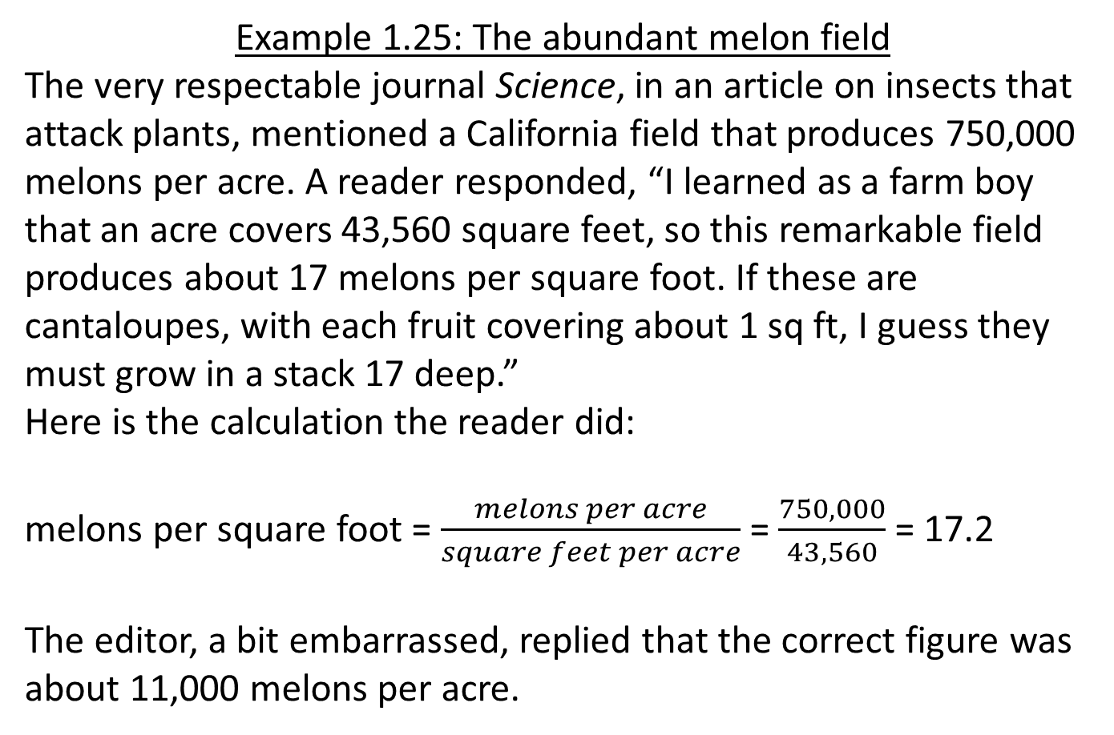
Example 1.25: The abundant melon field
The very respectable journal Science, in an article on insects that attack plants, mentioned a California field that produces 750,000 melons per acre. A reader responded, “I learned as a farm boy that an acre covers 43,560 square feet, so this remarkable field produces about 17 melons per square foot. If these are cantaloupes, with each fruit covering about 1 sq ft, I guess they must grow in a stack 17 deep.”
Here is the calculation the reader did:
melons per square foot = $\frac{melons per acre}{square feet per acre}$ = $\frac{750,000}{43,560}$ = 17.2
The editor, a bit embarrassed, replied that the correct figure was about 11,000 melons per acre.

Slide 14
Practice-
Complete 1.50-1.54 on pages 49-50

Slide 15
Are the numbers too good to be true?
We should be suspicious of numbers that seem too precise or regular.
Lack of consistency can lead to suspicion of data. But too much precision or regularity can be suspicious as well.

Slide 16
Example 1.26 More fake data
“Lasker had been asked to write a letter of support. But in reading two of Slutsky’s papers side by side, he suspected that the same ‘control’ animals had been used in both without mention of the fact in either. Identical data points appeared in both articles, but…the actual number of animals cited in each case was different. This suggested at best a sloppy approach to the facts. Almost immediately after being asked about the statistical discrepancies, Slutsky resigned and left San Diego.” In this case, suspicious regularity (identical data points) combined with inconsistency (different numbers of animals) led a careful reader to suspect fraud.

Slide 17
Is the arithmetic right?
Conclusions that are wrong or incomprehensible are often the result of blunders. Rates and percents cause particular trouble.
• "Of those aged more than 60 living alone, 34% are women and only 15% are men."
• "Does it matter that women are 550% (five and a half times) less likely than men to be appointed to a professional grade?"

Slide 18
Example 1.28-Summer is burglary time
An advertisement for a home security system says “When you go on vacation, burglars go to work. According to FBI statistics, over 26% of home burglaries take place between Memorial Day and Labor Day.”
Is this evidence that burglars are more active in the summertime?
Hint: there are 14 weeks between Memorial Day and Labor Day.

Slide 19
Percent Change
Percent change = $\frac{amount of change}{starting value}$ $×$100

Slide 20
Example 1.30 Stocks go up, stocks go down
a. ) In 1999, the NASDAQ composite index of stock prices rose from 2192.69 to 4069.31. What percent increase was this?
Percent change = $\frac{amount of change}{starting value}$ $×$ 100
= $\frac{4069.31 −2192.69}{2192.69}$ $×$ 100
= $\frac{1876.62}{2192.69} ×$ 100
= 85.6%

Slide 21
b.) In the week ending April 14,2000, the NASDAQ index dropped from 4446.17 to 3321.29. What percent decrease is this?
$\frac{amount of change}{starting value} ×$ 100 = $\frac{−1124.88}{4446.17}$ $×$ 100 = -25.3%

Slide 22
Is there a hidden agenda?
Lots of people feel strongly about issues, so strongly that they would like the numbers to support their feelings.
Often they choose carefully which numbers to report or squeeze the numbers into the shape they prefer.

Slide 23
Example 1.31 Heart disease in women
A highway billboard says simply “Half of all heart disease victims are women.”
What might be the agenda behind this true statement?
Perhaps the billboard sponsors just want to make women aware that they do face risks from heart disease. (Surveys show that many women underestimate the risk of heart disease)
On the other hand, the sponsors may be trying to fight the overemphasis placed on male heart disease

Slide 24
Complete exercises 1.55-1.60 on pages 55-60
Complete section 1.3 review on pages 57-58
1.61-1.68

